Slide 1
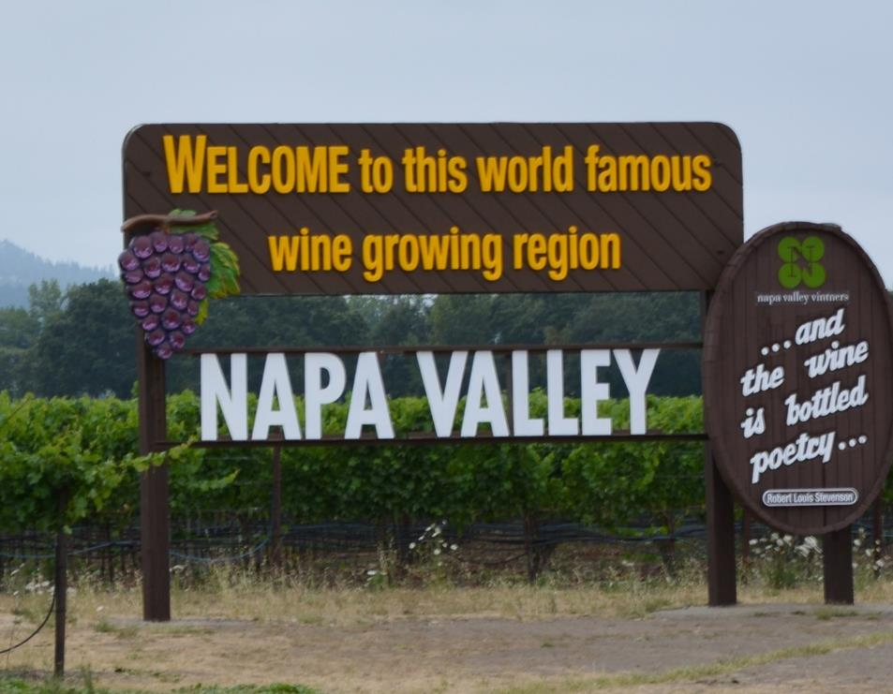



National Tasting Project 2019
Presented in partnership with the Napa Valley Vintners and Constellation Brands
Notes:
Welcome to the American Wine Society’s 2019 National Tasting Project.
I am ____________________, I will be leading you through Napa Valley today. This presentation was made possible with support from the Napa Valley Vintners and Constellation Brands.
Napa Valley is known for its innovative, quality-driven wines that stand among the best in the world, but most winemakers will tell you that quality starts in the vineyard. Their great diversity of soils, unique microclimates and collaboration within the vintner community compel their vintners and growers to refine their grape growing practices to produce the best possible wines.
This year the National Tasting Project committee is focusing on the terrior of Napa Valley. Their hope is that through the wines that you’ll be judging today you’ll have a greater appreciation for the expression the growing environment provides to the grapes.
Generally, “terroir” is defined as the complete natural environment in which a wine is produced—its soil, climate, terrain, elevation. However, a new element must be added to define the terroir of Napa Valley—that of “spirit.” For it is the spirit of the people who live and work here—the tenacity of the pioneer, the passion for excellence of the winemakers, the fearlessness of the entrepreneur, the respect for the land of the farmer—and most of all, the camaraderie of vintners who share ideas, techniques, equipment and care of the community, that makes Napa Valley and its wines unique.
[Photo source: Napa Valley Vintners and Constellation Brands]

Slide 2
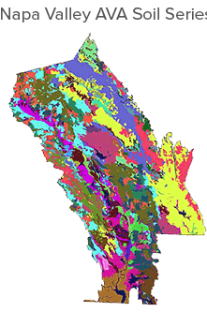
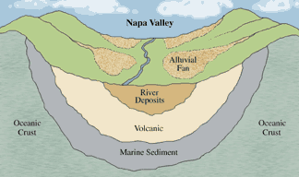
Great wines start from the ground up
33 Soil Series (map to right)
More than 100 soil variations
Soil structure & composition affect the grapes character
Notes:
Violent geologic forces and the steady march of time have created an agricultural Eden that produces some of the world’s most sought-after wine. Soils are created by this volcanic and seismic activity, along with marine, weather and other geologic events, evolved over millions of years.
The erosion and subsequent intermingling of this parent material has formed complex and highly varied soil compositions in the alluvial fans that emerge from the hillsides and spread out onto the valley floor.
The most famous of these alluvial fans is the Rutherford Bench.
Further stirring up the geologic pot were the periodic encroachment of San Pablo Bay, which once reached as far as the site of present-day Yountville, and the flooding and movement of the Napa River along the valley floor.
This set of unique occurrences has given rise to a soil diversity that represents more than 100 soil variations
The soil and climate determine what grapes to plant in each site, as each area has challenges and advantages to the winegrower.
Valley floor soils tend to be deeper and more fertile and produce vigorous growth so the crop must be tightly managed to produce concentrated grapes
On the hillsides the vine has to struggle to survive in the spare, rocky soils and naturally sets a smaller crop, producing smaller grapes of highly concentrated color and flavors
The temperature range (diurnal), sun hours, water and soil drainage, amongst numerous other factors much also be considered and managed.
[Photos sourced from: Napa Valley Vintners & Paula McKenzie-Nelsen]
======== Definitions ==========
Alluvial Fan: A fan-shaped mass of sediment, especially silt, sand, gravel, and boulders, deposited by a river when its flow is suddenly slowed. Alluvial fans typically form where a river pours out from a steep valley through mountains onto a flat plain. [Dictionary.com]
Marine sediment: Any deposit of insoluble material, primarily rock and soil particles, transported from land areas to the ocean by wind, ice, and rivers, as well as the remains of marine organisms, products of submarine volcanism, chemical precipitates from seawater, and materials from outer space (e.g., meteorites) that accumulate on the seafloor. [Britannica.com]
Silt: earthy matter, fine sand, or the like carried by moving or running water and deposited as a sediment. [Dictionary.com]
Soil Series: The lowest category of the national soil classification system. Soil series are the most homogenous (most alike) classes in the system of taxonomy.
Volcanic Soils: Soils that have formed where there is a lot of activity from volcanos often have special chemical properties. They are often very rich in nutrients and hold water well because of their volcanic ash content. These soils are called Andisols, and they are often very young, and acidic depending on which type of volcano they come from. Volcanic soils around the equator can be very well weathered, and can lose some of their nutrients unless there is another eruption. These materials can be very dark in color. [Soils4Teachers.com]

Slide 3
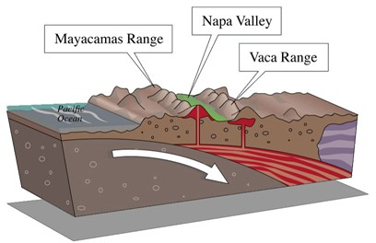
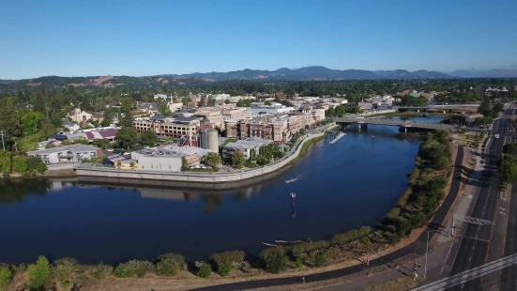
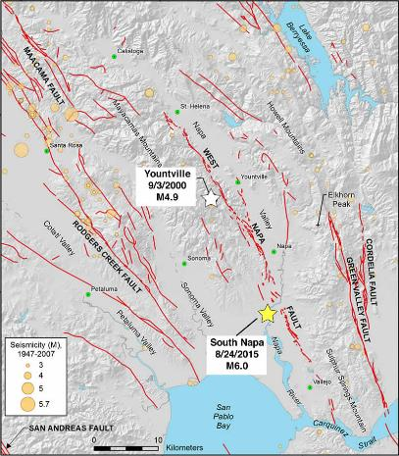
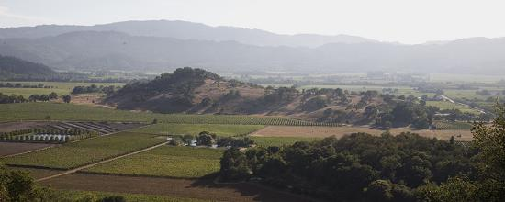
Geology
Notes:
At only 30 miles in length and five miles across at its widest point, the Napa Valley is a unique winegrowing region with a complex tapestry of vineyard locations that possess unique, individual personalities through soil and climate.
Napa Valley has had a very active and eventful geologic history. Over the course of 150 million years, the slow grinding of tectonic plates and robust volcanic activity have created the topography of the Napa Valley we know today. Due to the unique geographic position between the cold Pacific Ocean and the often hot Central Valley, a wide variety of climatic conditions exist within this small, contiguous area that are perfectly suited to producing a great variety of world-class wine grapes.
The two mountain ranges of the Napa Valley were created during the formation of the San Andreas fault. The Vaca [vah-CAH] Range, which forms the valley’s eastern boundary, shields Napa Valley from the scorching heat of the Central Valley while the Mayacamas [MY-ah-CAH-muss] Mountains separate the valley on the west from the cooler, marine influences experienced in neighboring Sonoma County. The hills and knolls you see on the valley floor are the product of huge megaslides from the Vaca mountains many years ago and affect weather patterns within those areas.
Bisecting the valley is the Napa River, which follows the valley's tapered contour. It begins as little more than a creek at its headwaters and grows into a fully navigable river in its southern stretches. The valley's topography changes with its length, from the windswept estuarine flats and gentle hills in the south to the valley's narrow tip at the town of Calistoga, cradled between the sheer walls of the Palisades at the foot of Mount St. Helena to the east and the forested Mayacamas Mountains to the west.
[Photos sourced from: Napa Valley Vintners, US Geological Service Earthquake Hazards Program, and YouTube]
=========
[NOTE: If members would like more information on the geology of Napa Valley, have them review the slide show from Napa Valley Vintners (https://slideplayer.com/slide/4322779/).]

Slide 4
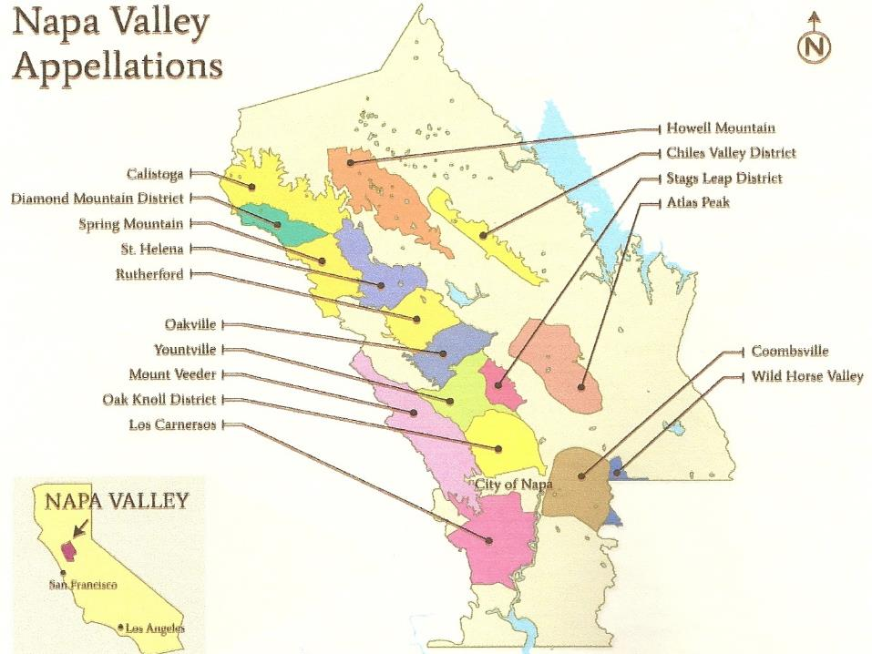
California’s First AVA
Notes:
[REFER PARTICIPANTS TO HANDOUT “Napa_Valley_Appellation_map.pdf”]
During the early years of winemaking in the Napa Valley, vineyards were often planted in patchwork patterns with many varieties growing side by side, as the practice of matching the most appropriate grape varieties to the particular soil and climatic conditions of a vineyard site was little understood at best. As Napa Valley became better known, vintners decided to market their wines collectively to distinguish them from and compare them to the wines of the great wine regions of the world.
Today, they have an intimate understanding of the connection between terroir and vine and have realized just how the diversity of Napa Valley’s soil, climate and terrain allow them to grow distinctive wines from specific areas within the valley.
This great diversity has led the vintners and growers to petition the government to create defined grape growing areas within Napa Valley, giving them names that reflect their regional designations--American Viticultural Areas, or AVAs.
The Napa Valley is itself an AVA, and it has been since it received its own designation in 1981. It is California's first recognized AVA and the second in the United States. Within the Napa Valley AVA exist 16 nested AVAs, including:
Atlas Peak
Calistoga
Chiles Valley District [ch-EYE-els]
Coombsville
Diamond Mountain District
Howell Mountain
Los Carneros [CAHR-nehr-ohss]
Mt. Veeder
Oak Knoll District of Napa Valley
Oakville
Rutherford
St. Helena
Spring Mountain District
Stags Leap District
Yountville
Wild Horse Valley
Only 9% of the 789 square mile county is planted to grapes. This small amount of grapes equals 4% of California’s production.
[Photo sourced from Napa Valley Vinters]
=========== Size Comparison ========
New York City = 302.6 square miles
Washington DC = 68.34 square miles
Rhode Island = 1,212 square miles

Slide 5
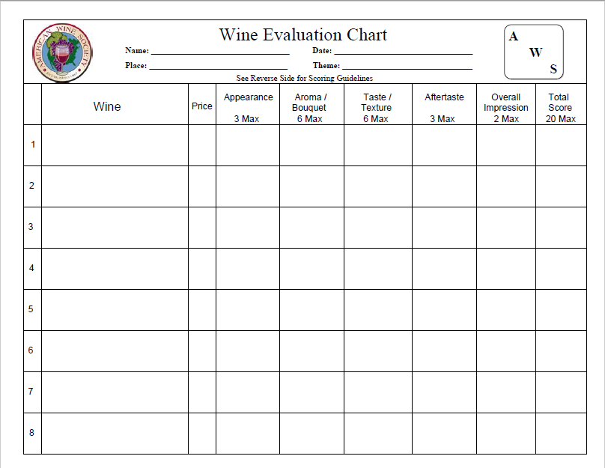
Wine Evaluation
Chart Refresher
0.5 point increments
Notes:
[WINE EVALUATION CHART SLIDES ARE OPTIONAL]
Just in case that someone has forgotten something they heard during Aaron Mandel’s YouTube presentation, I wanted to give you a quick refresher.
If we were judging for a competition, we’d specify what the panels would need to have their scores within proximity to one another for consensus. Example for “Two Points”, the highest and lowest score would need to be within two points of each other. Although for the National Tasting Project we’re not going to be that picky. Each column has an assigned score and we can use one-half point increments.

Slide 6
Quick Analysis – Identify Problems (deduct accordingly)
Notes:
[OPTIONAL]
We’re not spending a lot of time on the appearance. Wines should be clear, bright, and reflective. If you find otherwise, deduct from the 3 points.
The reverse side of the form has a few descriptors to help with giving the appropriate score for the wine in front of you.

Slide 7
What are you smelling?
Intensity – Complexity
Notes:
[OPTIONAL]
What are you smelling? Is it pleasant or off-putting? What is the intensity? Is there a lot going on in the aroma?
If you’re not sure of the smell or flavor, there’s an aroma wheel on the reverse.

Slide 8
What flavors are you tasting?
Intensity – Complexity –Structure – Balance
Notes:
[OPTIONAL]
What are you tasting? Similar to what you smelled. Also look for the balance between: acid, tannin, sugar, and alcohol.

Slide 9
How long does the pleasant flavor continue?
Short (~15s) – Medium (~30s) – Long (~45s)
[Document negative flavors too.]
Notes:
[OPTIONAL]
Consider the pleasant taste, how long does it continue? If there are negative flavors, annotate those as well.

Slide 10
Do you like it? How did the elements come together?
Notes:
[OPTIONAL]
Overall impression is where you get to be a little less objective in your analysis.

Slide 11
Public Math
[Less than 10 points: Flaws? or Grading too hard?]
Notes:
[OPTIONAL]
Unless you have a wine that contains at least one identifiable fault, the score should be at least 10.

Slide 12
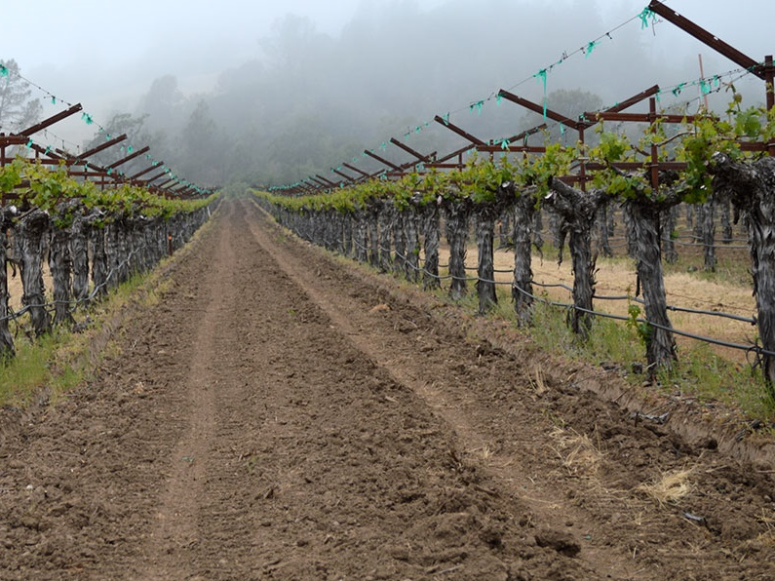
Appellations
Notes:
[Suggest that a “Napa_Valley_Appellation_map.pdf” be provided for at least every other person.]
Let us know look at some of the areas from which we’re about ready to taste wine.

Slide 13
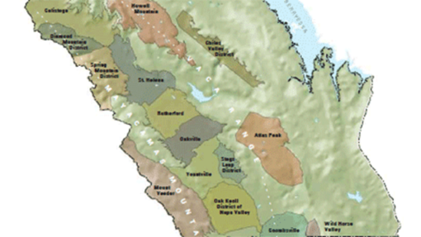
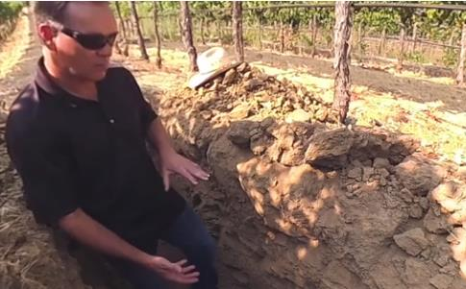
Dollarhide Ranch Estate Vineyard (Napa Valley AVA)
~500 acres of grapes on ~1,500 acre property
Large diurnal swing
Elevation: 600 to 1,100 feet
Varying soil—particularly fractured shale
Cab Sauv & Sauv Blanc; with other Bordeaux grapes plus Muscat Canelli & Chard
Notes:
Dollarhide Ranch Estate Vineyard is a 1,531 acre property with steep and rolling hills, some flat lands, seven lakes, and plenty of wildlife. St. Supéry [sue-peh-REE ] planted 498 acres of grapes throughout this property, leaving the rest in its natural state. The oldest vines are now more than 28 years old; primarily split between cabernet sauvignon and sauvignon blanc. Many of the other Bordeaux grapes are also found: malbec, petit verdot, merlot, semillon, and cabernet franc. Plus you can also find a few acres of muscat canelli & chardonnay around the property.
Vineyard elevations ranging from 600 to 1,100 feet above sea level, containing 7 different soil series and 13 different soil variations. The photo shows the fractured shale that is common in this particular block of Sauvignon blanc. Napa Valley’s warm days and cool nights are slightly exaggerated at Dollarhide because of its elevation and its distance from the moderating effects of San Pablo Bay.
[Source: St Supéry]
[Photos: Napa Valley Vintners and St Supéry]
************* REFERENCE *************
Muscat canelli is also known as muscat blanc à petits grains or moscato bianco.

Slide 14
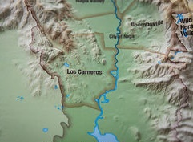
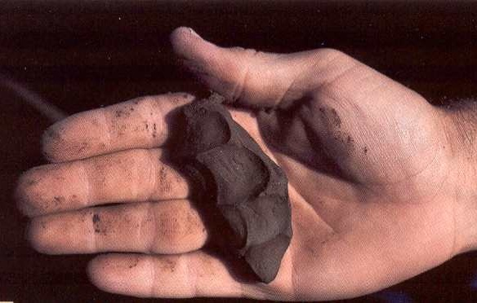
Los Carneros AVA
Cool with little diurnal change
Prevailing marine winds
Elevation: Sea level to 700 feet
Clay dominates
Chard, Merlot and Pinot noir
Notes:
Los Carneros [CAHR-nehr-ohss] is a cool AVA located in the southern portion of both Napa and Sonoma counties. The prevailing marine winds from the San Pablo [sahn pah-BLOH] Bay in the south and through the Petaluma [PEHT-ah-LOO-mah] Gap to the west help with the cooling. High temperatures during summer rarely exceed 80°F (27°C) and the area has a low diurnal range variation.
Carneros varies in elevation from sea level to 700 feet (0 to 213 meters). The area sees the least amount of rainfall in Napa Valley, up to only 24 inches (10 centimeters) annually.
Clay dominated area, very shallow in general, with more loam and hillside alluvials in the northern section of the AVA. Grape yields typically are restrained by the hard claypan subsoil, which prevents deep-rooting. The photo shows you an example of clay.
The area is known for growing minerally chardonnay, merlot with light tannins and sleek structure, and pinot noir with earthy notes.
[Photos: CanStock.com and MiGardener.com]
********* REFERENCE *************
Alluvial soil: a fine-grained fertile soil deposited by water flowing over flood plains or in river beds. [thefreedictionary.com/alluvial+soil]
Claypan: a dense, compact, slowly permeable layer in the subsoil having a much higher clay content than the overlying material, from which it is separated by a sharply defined boundary. [https://en.wikipedia.org/wiki/Claypan]
Loam: combines clay, silt, and sand to make the perfect soil for growing crops. The best loam soils have an equal amount of each, for the optimum permeability [https://countrysidenetwork.com/daily/growing/soil-compost/what-is-loam-soil/]

Slide 15

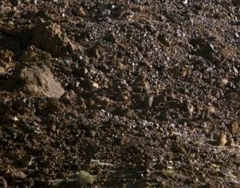
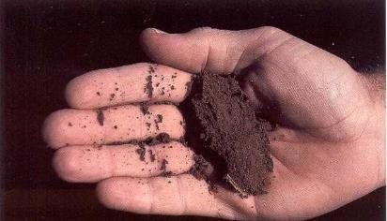
Oak Knoll District of Napa Valley AVA
Moderate to cool
Marine air & fog until late-morning
Elevation: Sea level to 800 feet
Alluvial with some volcanic & variable (gravel to silty clay loam)
Merlot, Chard, Cab Sauv, Sauv blanc & Rieseling
Notes:
The Oak Knoll District of Napa Valley is a moderate to cool AVA. Marine air and fog can remain until late-morning. Late afternoon breezes frequently occur, maintaining slightly cooler temperatures than upper valley. Mid-summer temperatures may reach 92°F (33°C) and drop to around 50°F (10°C) at night.
Oak Knoll varies in altitude from sea level to 800 feet (224 meters) and sees about 36 inches (90 centimeters) of rain annually.
The valley's largest alluvial fan formed by Dry Creek creates the defining feature of the district. The northwest area is composed of volcanically derived soils, with stony or gravelly consistency [middle left photo]. South and east areas are transitional from gravel to silty clay loam [bottom left photo].
This area is known for planting merlot, chardonnay, cabernet sauvignon, sauvignon blanc and Riesling.
[Photos sourced: Napa Valley Vintners, Colourbox and USDA]
************* NOTE *******
Dry Creek is a small body of water that flows through the area.

Slide 16

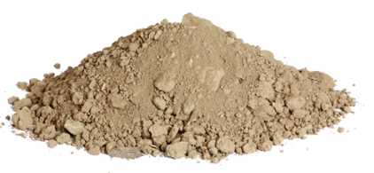
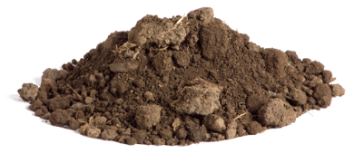
Oakville AVA
Moderately warm days
Night & early morning fog
Elevation: 130 – 1,000 feet
Sedimentary gravelly alluvial loam (west); more volcanic (east)
Cab Sauv, Cab Franc, Merlot, and Sauv blanc
Notes:
Next up is the Oakville AVA. A moderately warm region with temperatures commonly in the mid-90°F (34-35.5°C) range in high summer, but also still strongly affected by night and early morning fog, which helps keep acidity levels good. The east side of the AVA receives warmer afternoon sun.
The AVA’s elevation variation from 130 to 1,000 feet (40 to 305 meter) and it receives approximately 35 inches (87.5 cm) annually.
Primarily sedimentary gravelly alluvial loams [middle left photo] are found on the western side of the region with more volcanic but heavier soils [bottom left] on the eastern side. The soils are low to moderate fertility and fairly deep, with average water retention.
The AVA principally grows: cabernet sauvignon, cabernet franc, merlot and sauvignon blanc.
[Photos sourced: Napa Valley Vintners, Nickel and Nickel Winery]

Slide 17

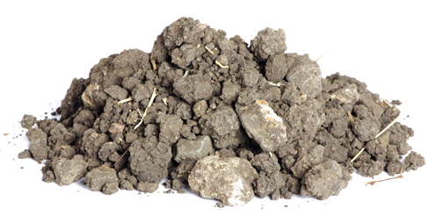
Stag’s Leap District AVA
Moderately warm days
Marine winds
Elevation: Sea level to 400 feet
Volcanic gravel-loam valley floor; rocky hillside; hard clay sub-soil
Cab Sauv, Merlot, Sauv blanc
Notes:
Stag’s Leap District AVA is a moderately warm region with afternoon marine winds acting as an "air-conditioner" to cool the warmer air radiating off the bare rocks of Stags Leap itself and the surrounding hillsides. Mid-summer temperatures can reach 100°F (37.7°C), but more regularly are in mid-90° range (34° to 36°C).
Stag’s Leap District varies from sea level to 400 feet (20 to 123 meter) elevation and it receives 30 inches (75 centimeter) annually.
The soils in the region consist of volcanic gravel-loams on the floor of the valley, with rocky hillsides, and low to moderate fertility due to hard clay subsoils.
The principle varieties grown within Stag’s Leap District are cabernet sauvignon, merlot and sauvignon blanc.
[Photos sourced: Napa Valley Vintners, Nickel and Nickel Winery]

Slide 18
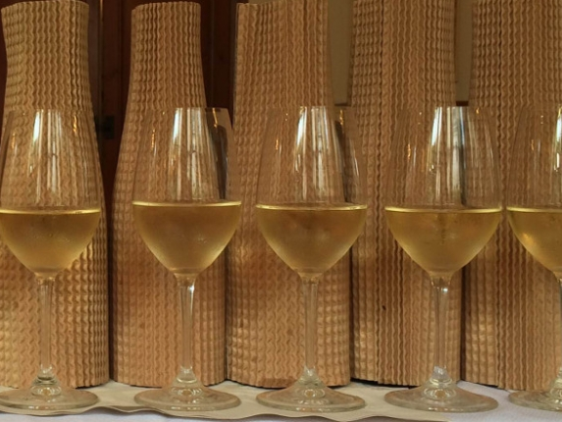
How About Some White Wines?
Notes:
At this time we’re going to taste our white wines. Once everyone has judged the whites, we’re reveal them to you.

Slide 19
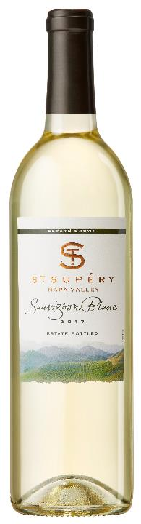
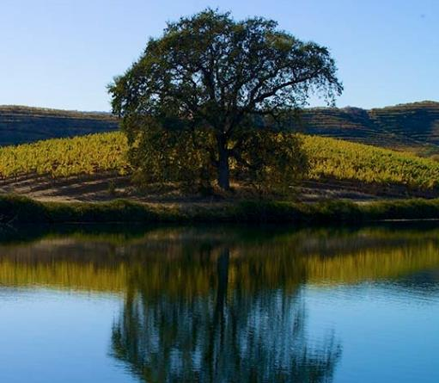

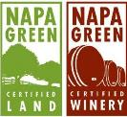
St. Supéry
2017 Sauvignon Blanc
Appellation | Napa Valley
Vineyard | Dollarhide Estate Vineyard
Variety | 100% Sauvignon Blanc
pH | 3.24
T.A. | 6.5 g/L
R.S. | 0.2%
ABV | 13.5%
Harvest | Aug 21-Sep 5, 2017
Vinification | Stainless steel
Aging | N/A
Bottling | Dec 2017
$18
Notes:
St. Supéry [SEH-nt sue-peh-REE ] Estate Vineyards and Winery is a 100% Estate Grown, sustainably farmed winery located in the renowned Rutherford growing region in the heart of Napa Valley.
Located in the northeastern hills of Napa Valley, the Dollarhide Estate Ranch is a valley within a valley and has 1,530-plus acres, 500 acres planted to the vineyard. The oldest vines at Dollarhide Estate, now more than 30 years old, produce the full-bodied, robust Cabernet Sauvignon and distinctive Sauvignon Blanc wines upon which St. Supéry’s reputation was built. Vineyard elevations ranging from 600 to 1,100 feet above sea level, seven different soil series, 13 soil variations and unique microclimates, combine at Dollarhide to create an especially accommodating growing environment for Bordeaux grape varieties.
Each parcel is planted with fruit quality and distinct character in mind. These parcels are then farmed individually so that the vines will thrive in their distinctive locations. The St. Supéry team is able to match the right soils with the optimum combination of rootstock, clone selection and cultivation practices. The diversity of terrain results in a wide selection of fruit characteristics with which their winemakers work in producing estate Sauvignon Blanc and Cabernet Sauvignon, estate blends and the Dollarhide Estate single vineyard wines.
Napa Green is a comprehensive sustainability certification program for vineyards and wineries in the Napa Valley. Napa Green Land is a third-party vineyard certification which involves a custom, whole-farm conservation plan. Napa Green Winery certifies that the winery implements at least 100 sustainability and environmental stewardship practices.
[Technical Information Source: St. Supéry Estate Vineyards and Winery and https://NapaGreen.org/about/]
[Photos Source: St. Supéry Estate Vineyards and Winery; Napa Green Vineyard and Napa Green Winery logos used with permission. [https://napagreen.org/]]

Slide 20
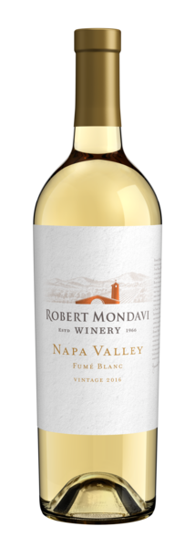
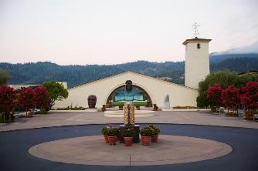
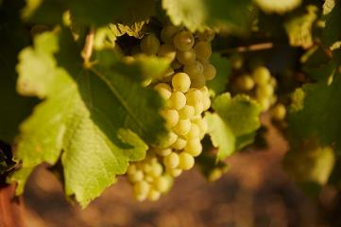


Robert Mondavi Winery
2016 Fumé Blanc
Appellation | Napa Valley
Vineyard | 59% Wappo Hill Vineyard 39% To Kalon Vineyard 2% Oakville District
Variety | 92% Sauvignon blanc 8% Semillon
pH | 3.14
T.A. | 6.5 g/L
R.S. | 0.04%
ABV | 14.5%
Harvest | Aug 3-Sep 22, 2016
Vinification | 2% new French oak
Aging | 6 month sûr lie
Bottling | April 2017
$24
Notes:
The grapes were hand-harvested in the cool of the morning and gently pressed as whole clusters--minimizing skin contact--to retain freshness and vibrancy. All of the juice was barrel fermented for added richness and complexity, with 2% in new French oak for added texture and complexity. The new wine was aged for six (6) months in 60-gallon French oak barrels, sûr lie [suhr LEE] (on the yeast lees), and hand stirred twice a month for a creamy texture and seamless integration of flavors. The addition of a small percentage of Semillon gives the final blend a broader mouthfeel and enhanced complexity.
This wine was sourced from Wappo Hill Vineyard in the Stag’s Leap District and To Kalon Vineyard and other vineyards in the Oakville District.
[Photos sources: Constellation Brands; Certified California Sustainable Winegrowing logo used with permission. [https://www.sustainablewinegrowing.org/]; Napa Green]]

Slide 21
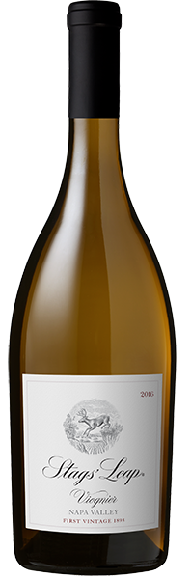
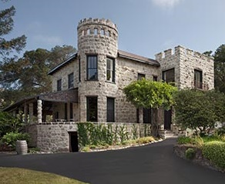
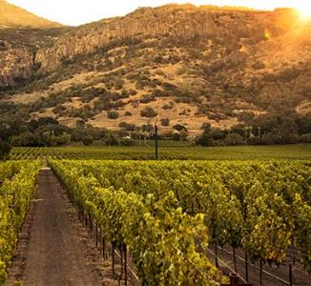
Stags’ Leap Winery
2017 Viognier
Appellation | Napa Valley
Vineyard | 3 vineyards in Oak Knoll & Carneros AVAs
Variety | 100% Viognier
ABV | 14.3%
Harvest | Hand harvested
Vinification | Whole-cluster pressed; 100% neutral French Oak
Aging | 4 months sûr lie
$30
Notes:
The first vintage from Stags’ Leap Winery occurred in 1893, although from 1908 through 1972 they only sold grapes to other wineries. During most of the 20th century, the manor house (top photo) served as a fashionable country resort. The manor was damaged in the 2014 earthquakes, but was renovated in 2016.
In 1988 major vineyard replanting occurred to match varietals and rootstock to the varied soil structures.
[Source: Stags’ Leap Winery]

Slide 22
More Appellations
Notes:
Let us know look at some additional areas from which we’re about ready to taste wine.

Slide 23

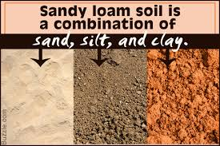
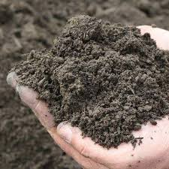
Calistoga AVA
Warm to hot
Cool afternoon/evening ocean breezes through Chalk Hill Gap
Elevation: 300-1200 feet
Loam on alluvial fans & clay-silt in valley center
Cab Sauv, Zin, Syrah, Petite Sirah
Notes:
Calistoga [KAHL-isst-oh-gah] AVA is warm to hot, depending upon time of year. Daytime summer temperatures may peak above 100° (38°C) and fall to low 40s°(6°C) at night due to cool afternoon and evening breezes drawn in from the Chalk Hill Gap from the Pacific.
The elevation varies from 300 to 1200 feet (92 to 370 meter). The rainfall reaches up to 60 inches (96.5 to 150 centemeters) annually.
The AVA consists almost completely of volcanic origin. Soils range from rocky, stony loam on the hillsides, to gravelly or cobbly loams on the alluvial fans, and heavier clay-silt soils in the valley center areas.
The AVA is known for cabernet sauvignon, zinfandel, syrah, and petite sirah.

Slide 24
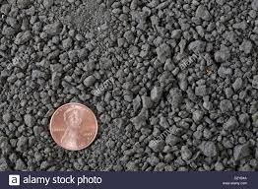
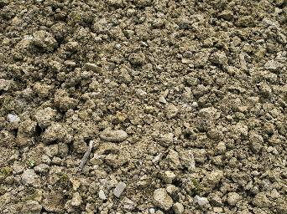
Chiles Valley District AVA
Moderately warm days
Night fog
Chilly nights
Elevation: 600-1200 feet
Silty-clay on valley floor; clay-loam & stony-clay on hillside
Cab Sauv, Merlot, Cab Franc, Zin
Notes:
Chiles [CHEYE-lz] Valley District AVA has fairly warm summer days (mid-80°F plus/28.8 to 31°C), but due to higher elevation and summer fog at night, quite chilly at night (below 50°F/10°C). With colder winters and spring, as well as strong winds, harvest comes later than on valley floor at Oakville.
The AVA rests between 600 to 1200 feet (182 to 366 meters) with 35 inches (88 centimeters) of rain annually.
The valley floor of Chiles Valley District are primarily alluvial soils with silty-clay composition (middle left photo) of marine origin, with good fertility. Hillsides show more clay-loam and stony-clay composition (bottom left photo), mostly marine in origin, with some volcanic outcropping, and less fertility.
The principal varieties grown in Chiles Valley District are cabernet sauvignon, merlot, cabernet franc, and zinfandel.
[Photos sourced: Napa Valley Vintners, 123RF.com and Alamy Stock Photos]

Slide 25
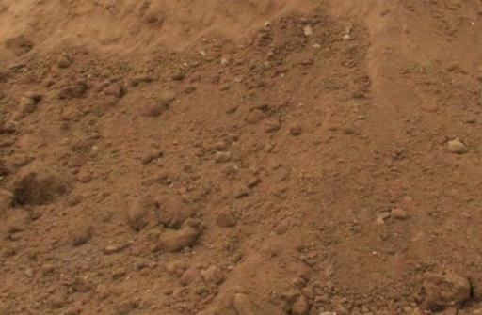
Mount Veeder AVA
Cool to moderate; typically above the fog line
Elevation: 500-2600 feet
Sedimentary; sandy or sandy loam
Cab Sauv, Merlot, Zin & Chardonnay
Notes:
Mount Veeder is a cool to moderate AVA, with most vineyards above the fog-line, meaning warmer nights and cooler days and less diurnal range than the valley floor. Typical mid-summer high temperatures about 85°F (29°C).
The AVA is between 500 and 2600 feet (152 and 792 meters). It typically receives about 35 inches (87.5 centimeters) of rain annually.
Mount Veeder is primarily an island of ancient seabed, pushed up in the mountain’s formation five million years ago. This is the only Napa Valley appellation that can claim this unique geologic phenomenon. The sedimentary based, former seabed, is shallow and generally well drained, as well as more acidic, with low fertility. Most have a sandy or sandy-loam texture.
The principal varieties are cabernet sauvignon, merlot, zinfandel, and chardonnay. Ageability is a hallmark of Mount Veeder wine.
[Photos sourced: Napa Valley Vintners, Stone & Soil Depot, Inc.]
[Source: www.mountveederwines.com/mountain.php]

Slide 26
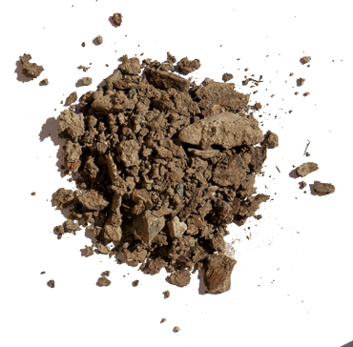
Rutherford AVA
Moderately warm
Marginal morning fog influence
Large diurnal change
Elevation: 155-500 feet
Sedimentary, gravelly-sand & alluvial
Cab Sauv, Merlot, Cab Franc, Zin & Sauv blanc
Notes:
The Rutherford AVA is moderately warm, although marginally influenced by early morning fog. The western bench area is cooler, with less late afternoon sun and tempered by afternoon marine winds. Usual summer peak temperatures are mid-90°F (34-35.5°C) with a large diurnal range.
The AVA sits between 155 and 500 feet (47 and 152 meters) in elevation. It receives 38 inches (95 cm) of rain annually.
The western benchland is sedimentary, gravelly-sandy and alluvial, with good water retention and moderate fertility. The eastern side has more volcanic soils, moderately deep and more fertile.
This area is known for growing cabernet sauvignon, merlot, cabernet franc, zinfandel and some sauvignon blanc.
[Photos sourced: Napa Valley Vintners; Whitehall Lane Winery]

Slide 27

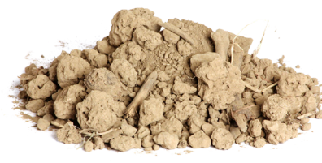
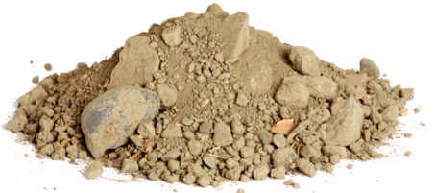
St. Helena AVA
Warm with limited fog & wind interaction
Elevation: 200-475 feet
Sedimentary, gravel-clay (south & west); deeper & more fertile volcanic (north & east)
Cab Sauv, Cab Franc, Merlot, Syrah, Zin & Sauv Blanc
Notes:
Saint Helena AVA is a warm region. This is due to greater protection from western hills, with less fog or wind incursions. This narrowest part of the Napa Valley floor provides more heat reflection off the hillsides. Mid-summer temperature peak is often in mid-to-high 90°s (35° to 37°C).
Saint Helena varies in elevation from 200 to 475 feet (46 to 145 meters) and receives rainfall from 38 to 40 inches (95 to 101 centimeters) annually.
The south and west borders are more sedimentary, gravel-clay soils (lower left photo), with lower fertility and moderate water retention. Further north and to the east soils are prevalently volcanic (center photo) in origin and are deeper and more fertile.
Here you’ll find plantings of cabernet sauvignon, cabernet franc, merlot, syrah, zinfandel and sauvignon blanc.
[Photos sourced: Napa Valley Vintners; Nickel and Nickel]

Slide 28

Let’s Continue…
Notes:
Now we’ll continue with out tasting by getting to our reds today. We’ll then go through the remainder of the slides.

Slide 29
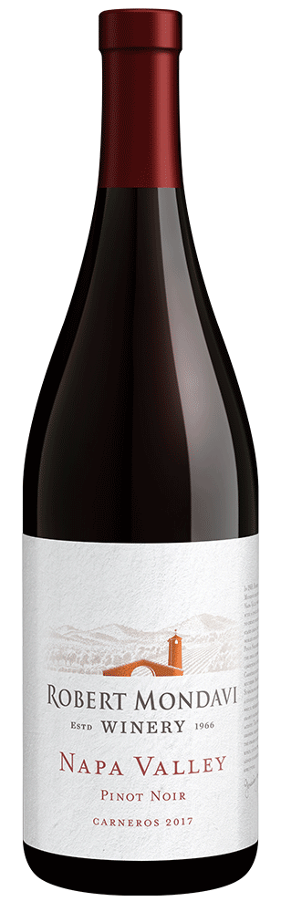
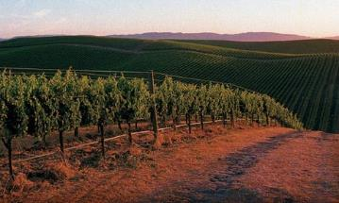
Robert Mondavi Winery
2017 Pinot Noir
Appellation | Napa Valley
Vineyard | Select vineyard blocks in Los Carneros
Variety | 100% Pinot Noir
pH | 3.65
T.A. | 6.3 g/L
R.S. | 0.037%
ABV | 13.5
Harvest | Hand harvested; Aug 28 to Sep 2, 2017
Vinification | Whole cluster or French oak fermentation; MLF in 27% new French oak
Aging | 7 months
Bottling | June 2018
$26
Notes:
The foggy, wind-swept slopes of the Carneros region are an ideal home for Pinot Noir, a cool-climate loving grape. Great care is needed to produce fine pinot noir, a notoriously challenging and fragile variety, and the marine influences allow for gradual, flavor-building hang time needed for peak flavor maturity. The low-nutrient soils provide lower yields, and the fewer berries that do grow, with less competition for natural resources, have rich, concentrated flavors and produce a deep-colored wine.
The grapes were hand harvested into small bins in the cool of the morning, then gently de-stemmed and crushed. Select vineyard blocks were fermented as whole clusters for added depth of flavor. A portion of the wine was fermented in French oak fermentation tanks to enhance the extraction of color and flavor during the 18 days of skin contact. The new wine was gently pressed and transferred to French Oak barrels (27% new) for malolactic fermentation and seven (7) months of aging, seamlessly integrating the fruit and oak. The wine was bottled in June 2018.
A series of wildfires at the beginning of October made international headlines, but the early harvest ensured the majority of Mondavi’s grapes were picked and already processed in the cellar before the fires began.
[Photos sourced from: Robert Mondavi Winery; Napa Green]

Slide 30

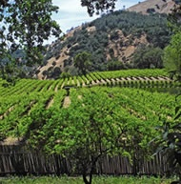
Green & Red Vineyard
2014 Zinfandel
Appellation | Chiles Valley District
Vineyard | Chiles Mill Vineyard (Estate)
Variety | Zinfandel
pH | 3.56
T.A. | 6.0 g/L
ABV | 15.3%
Harvest | Sep 16-19, 2014
Vinification | Open top fermenter (3 days cold soak; 10 days fermentation)
Aging | 14 months in 20% new oak (70% American/30% French)
Bottling | Apr 6, 2016
$29
Notes:
Located at elevations from 1000 to 1200 feet, the vineyard overlooks upper Chiles Canyon and remnant walls of the grist mill built by pioneer J.B. Chiles.
Green & Red Vineyard, named for its red iron soils veined with green serpentine, is located in the steep hills on the east side of Napa Valley. The planting was started in 1972 on ground that was originally a vineyard in the 1890's. 31 acres of vineyard are planted within the 200 acre parcel. Three separate mountain vineyards, Chiles Mill, Tip Top and Catacula [KAHT-tah-KOO-lah] are located at different elevations and different exposures.
[Photos sourced: Green & Red Vineyard]
************ NOTE ****************
Green Serpentine: Mottled golden-green color resembling snakeskin.

Slide 31
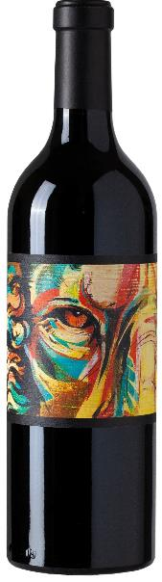
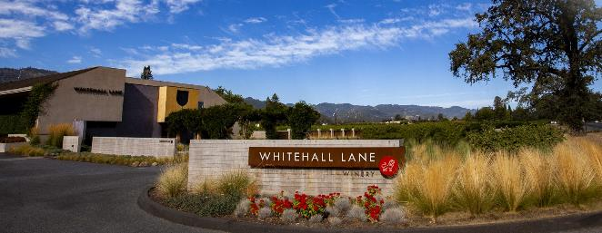
Whitehall Lane Winery
2015 Tre Leoni
Appellation | Napa Valley
Vineyard | Estate in St. Helena, Rutherford & Oak Knoll
Variety | Cab Sauv, Merlot, Syrah, & Zin
ABV | 14.7%
Aging | 18 months
$29
Notes:
Three generations of the Leonardini Family (Tre Leoni) are responsible for this expertly made proprietary blend of cabernet sauvignon, merlot, syrah, and zinfandel. Each grape varietal was fermented and aged as separate lots in French and American oak barrels. Winemaker Jason Moulton tasted through each lot and put the final blend together in early 2017 after aging 18 months. The lion’s share of the wine is cabernet sauvignon with equal, lesser percentages of merlot, syrah, and a small amount of zinfandel. is wine was bottled unfined and unfiltered.
Label art is a bold view of artist Jacqui Oakley’s oil on canvas painting.
[Photos: Whitehall Lane Winery]
**************** NOTE ************
Colloid: Macromolecules (i.e., soluble proteins), or molecular complexes (i.e., clay) dispersed in a medium by random, heat-induced (Brownian) molecular movement. [Ronald S. Jackson, Wine Science: Principles and Applications, 4th ed.]
Unfined: Not undergoing a process to add particulates (i.e., bentonite) or macromolecules (i.e., gelatin) to
remove excess tannins, dissolved proteins, or other colloidal material. [Ronald S. Jackson, Wine Science: Principles and Applications, 4th ed.]

Slide 32
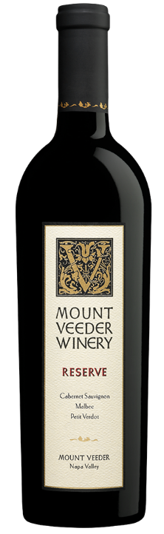
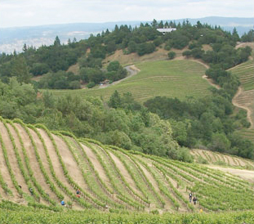
Mount Veeder Winery
2015 Reserve
Appellation | Mount Veeder
Variety | 84% Cab Sauv, 12% Malbec, 4% Petit Verdot
pH | 3.67
T.A. | 6.5 g/L
ABV | 14.5%
Harvest | Sep 10 to Oct 8, 2015
Vinification | 4 days cold soak; 24 days fermentation & maceration
Aging | 20 months in small oak barrels (100% new)
$44
Notes:
The philosophy at Mount Veeder Winery is that each of their wines has its own remarkable way of expressing the mountain soil from which it was born. They believe that great wines are a reflection of their terroir—the combination of soil, topography, microclimate and people—and they believe that excellent grapes handled with minimal processing have the potential to produce the greatest wines.
The thin, rocky soils and rugged terrain on Mount Veeder make farming the vineyards a challenge. Cultivation and harvesting is done entirely by hand. Water is scarce and drains quickly through the volcanic mountain soil.
Both Mount Veeder Winery and the rugged appellation take their names from an ancient volcano—a nearly 2,700 foot peak that crowns the southeast section of the Mayacamas Range, running between Napa and Sonoma. The Mount Veeder appellation encompasses 25 square miles of some of the steepest vineyards in California.
[Photos sourced: Mount Veeder Winery]

Slide 33
Remainder of Napa Appellations
Notes:
Let us know look at some additional AVAs within Napa Valley, even though we won’t be tasting their wine today.

Slide 34
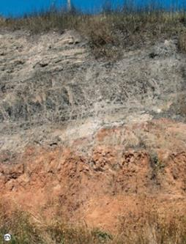
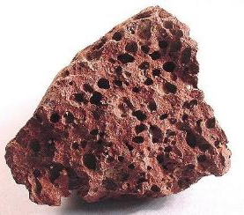
Atlas Peak AVA
Cool, mountain influence
Above fog line
Low diurnal change
Elevation: 760-2600 feet
Volcanic soil (red basalt)
Cab Sauv & Chardonnay
Notes:
The cool, mountain-influences Atlas Peak AVA has temperatures about 10–15° cooler than the valley floor in summer. It is above the fog line. There is low day-to-night temperature range. And summer temperatures rarely rising above 90°F (32.2°C).
The elevation of the AVA is 760 to 2600 feet (232 to 792 meters). The AVA receives about 38 inches (96 cm) of rain annually.
Atlas Peak’s soils are volcanic in origin, with basaltic red color, shallow with limited water retention, so irrigation is often essential. [both photos are red basalt]
The principle varieties grown in this region are cabernet sauvignon and chardonnay.

Slide 35
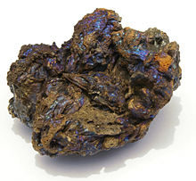
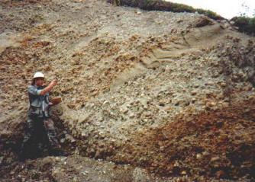
Coombsville AVA
Cooler than most other Napa Valley AVAs
Moderated by proximity to San Pablo Bay
Elevation: 100-1000 feet
Volcanic rock & alluvial deposits
Cab Sauv, Merlot, Chard, Syrah, Pinot Noir
Notes:
Coombsville AVA’s weather is moderated by its proximity to the San Pablo Bay. Daily average high temperatures can be as much as 10 degrees cooler during the hot months than most other AVAs, and heat spikes tend to be less severe.
The AVA is between 100 and 1,000 feet (30 and 305 meters) in elevations. This region only receives about 25 inches (65 centimeters) of rain annually.
Coombsville AVA’s soil is primarily weathered volcanic rock and alluvial deposits from the Vaca Range that surrounds the region.
The primary plantings in this AVA are dominated by cabernet sauvignon on the hillsides with merlot, chardonnay, syrah and pinot noir in the lower, cooler sites.

Slide 36
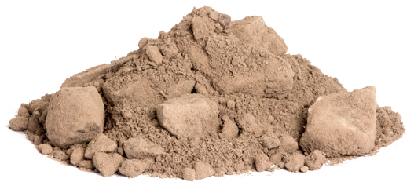
Diamond Mountain District AVA
Moderately warm
Elevation: 400-2200 feet
Uplifted volcanic, fine-grain & sedimentary soils
Cab Sauv, Cab Franc
Notes:
The Diamond Mountain District has moderately warm temperatures with lower maximum temperatures and higher minimum temperatures than the valley floor, due to topography and altitude. 50 to 90°F in growing season (10 to 32°C).
It’s elevation varies from 400 to 2200 feet (122 to 671 meters) and it receives 40 to 55 inches (135 centimeters) annually.
The AVA’s consists of residual uplifted soils of volcanic origin, often reddish and very fine-grained, even gritty in texture, composed of both weathered sedimentary and volcanic origin.
You can find primarily cabernet sauvignon and cabernet franc.

Slide 37
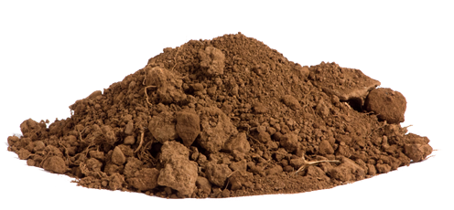
Howell Mountain AVA
Above fog line
Warmer/drier than other AVAs
  More hours of sunshine
  Little-to-no marine influence
Elevation: 1400-2600 feet
Volcanic
Cab Sauv, Merlot, Zinfandel, Chardonnay, Viognier
Notes:
Howell Mountain AVA is located above the fog line on the eastern side of the valley, the AVA is warmer and drier than other AVAs with more hours of sunshine and little-to-no marine influence.
The AVA rises 1400 to 2600 feet (427 to 792 meters). It has significantly more rain annually; receiving 40 to 50 inches (125 centimeters).
The soils found in Howell Mountain AVA are predominantly volcanic, shallow and infertile. Drainage is high, fertility low.
You’ll find cabernet sauvignon, merlot, zinfandel, chardonnay, and viognier growing here.

Slide 38


Spring Mountain District AVA
Cool to moderate
Elevation: 400-2200 feet
Uplifted volcanic, fine-grain & sedimentary soils
Cab Sauv, Cab Franc, Merlot, Zin & Chard
Notes:
Going back across the valley to Spring Mountain District AVA. It is a cool to moderate region depending on elevation and aspect. Most vineyards sit above the fog line, providing warmer nights and cooler days than the valley floor. typical mid-summer high temperatures reach 85°F (29°C).
A significant variation in elevation occurs within the AVA; rising from 600 to 2600 feet (183 to 792 meters). This is another region within Napa Valley that receives significant annual rainfall; receiving between 40 and 50 inches (125 centimeters) annually.
The soils found within the Spring Mountain District AVA are primarily sedimentary; weathered sandstone/shale, loamy and friable in texture. Drainage is high, fertility low.
The principal varieties of the AVA are cabernet sauvignon, cabernet franc, merlot, zinfandel, and chardonnay.
[Photos sourced: Napa Valley Vintners, Marli Miller Photography, and Minroc Science]

Slide 39



Wild Horse Valley AVA
Coolest in Napa Valley
  Elevation
  Proximity to San Pablo Bay
Elevation: 850 to 2130 feet
Volcanic
Pinot Noir & Chardonnay
Notes:
On the southern side of Napa Valley we have the Wild Horse Valley AVA. Due to elevation and proximity to San Pablo Bay, it is the coolest of all the Napa Valley AVAs. The air mass that passes over Carneros cools another 10 degrees by the time it rises to the AVA.
Although close to San Pablo Bay it still have an elevation change between 850 to 2130 feet (259 to 650 meters). The AVA receives approximately 35 inches (94 cm) of rain annually.
Its soils are volcanic in origin, with basaltic red color, shallow with limited water retention, so irrigation is often essential.
You’ll find pinot noir and chardonnay growing in significant quantities in this region.
[Photos sourced: Napa Valley Vintners and Cochise College]

Slide 40



Yountville
Moderate w/ cool marine & fog influence
Elevation: 20-200 feet
Gravelly silt loam & Gravelly alluvial soils
Cab Sauv & Merlot
Notes:
Yountville has a moderate climate, with cool marine influence and fog contributing to cool summer mornings and the strong breezes of San Pablo Bay keeping afternoons more comfortable than further up valley. Mid-summer peak temperatures may reach low 90°F (33°C), with noticeable diurnal fluctuation to the mid-50°F range (13°C).
There is little elevation change, with the region being between 20 and 200 feet (6 and 61 meters). It sees approximately 32 inches (80 centimeters) of rain annually.
Principally you will find gravelly silt loams (middle left photo), sedimentary in origin, and gravelly alluvial soils with rock (bottom center photo), moderately fertile.
The principal varieties for this AVA are: cabernet sauvignon and merlot.
[Photos sourced: Napa Valley Vintners, SFGate, and 123rf.com]

Slide 41

Thank you for participating in the 2019 NTP!
Notes:
Thank you for joining us today as we tasted our way through Napa Valley. I’m sure we will have to revisit their wines again at a future chapter event.
Don’t forget to turn in your score sheets with _______________________________. He/she/I will get the sheets turned into the National Tasting Project committee for analysis.
[Photos sourced from: Napa Valley Vintners]
***************** NOTES ***************
National Tasting Project Committee thanks you for participating.
Questions on the slides can be addressed to our slideshow editor Vince Williams at ntp@americanwinesociety.org
*********** ADDITIONAL CREDITS *****************
Soil Survey Staff. 2014. Keys to Soil Taxonomy, 12th ed. USDA-Natural Resources Conservation Service, Washington, DC.
Soil Survey Staff. 2015. Illustrated guide to soil taxonomy. U.S. Department of Agriculture, Natural Resources Conservation Service, National Soil Survey Center, Lincoln, Nebraska.

